Slide 1

ANOMALY DETECTION IN IoT NETWORKS USING MACHINE LEARNING
By- Group 4

Slide 2

What is IoT?
The Internet of Things (IoT) refers to the interconnection of devices , electronics, software, sensors, and network connectivity, enabling them to collect and exchange data.
IoT allows these devices to communicate and interact with each other, as well as with centralized systems and applications, creating a vast network of connected "things."

Slide 3

Importance of Identifying Intrusions in IoT Networks
Data Privacy and Security
Network Integrity
Prevention of Malicious Activities
Protection Against Physical Damage
Compliance Requirements
Maintaining Trust
Cost Savings

Slide 4
Problem Statement
The exponential growth of IoT devices has amplified network vulnerabilities and cyber threats.
The expansion of internet-connected devices has broadened the potential attack surface.
Traditional security measures struggle to keep pace with the intricate and evolving landscape of IoT threats.
Ensuring the security of IoT networks is paramount to mitigating cyber risks.
Proactive measures are essential for preserving data integrity and sustaining system reliability.
Implementing machine learning algorithms to analyze the large amounts of IoT data for anomaly detection.
Developing predictive models to anticipate and preempt potential security breaches.

Slide 5
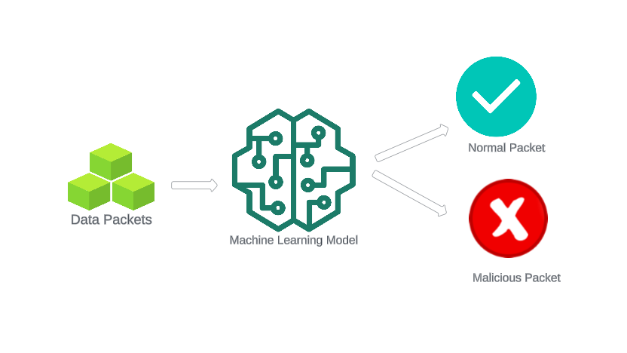
Objective
The main objective of this presentation is to outline the development and deployment of a machine learning model specifically tailored for classifying network packets within IoT environments either as normal or malicious packet.

Slide 6
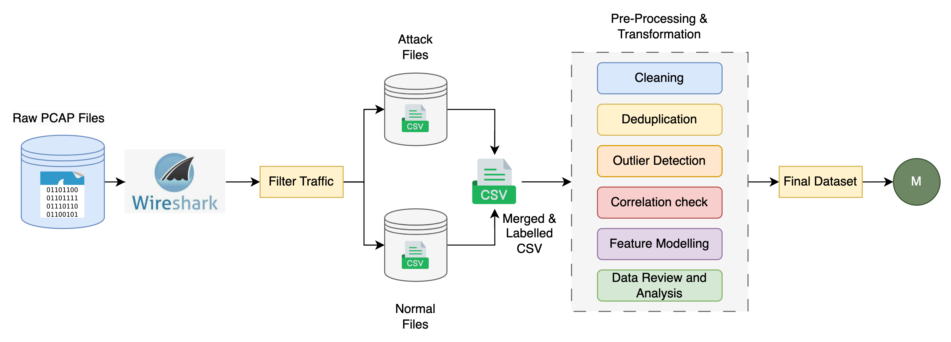
Pre-processing & Transformation Flow

Slide 7
Data Collection
Source:The IoT Environment Dataset (https://ocslab.hksecurity.net/Datasets/iot-environment-dataset) consists a collection of network traffic data from IoT environments.
Data obtained is in Packet Capture (PCAP) format.
The packets encompass instances of both attack and regular network traffic from IoT networks.
The obtained Pcap files are filtererd to separate normal instances and attack instances using wireshark.
These filtered Pcap files are saved.

Slide 8
Data Preparation
Filtered and saved separate Pcap files containing both normal and malicious network traffic.
Employed CICFlowMeter to extract additional features from the filtered pcap files, enriching the dataset's descriptive capabilities.
Utilized CICFlowMeter to extract features from both normal and malicious pcap files, capturing unique characteristics of each traffic type.
Converted extracted features from both types of traffic into CSV format for compatibility and uniformity in subsequent analysis.
Merged feature-rich CSV files from both normal and malicious traffic to create a unified dataset for comprehensive analysis.
Additional label column is added to specify if the row belongs to a normal instance or an attack one.

Slide 9
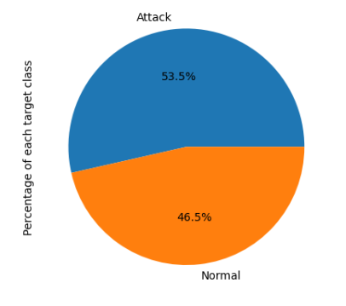
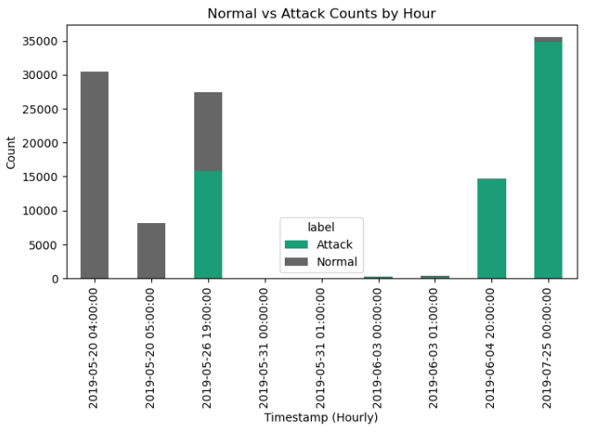
EDA
Removing any duplicate entries in the merged dataset.
Identifying and removing nulls

Slide 10
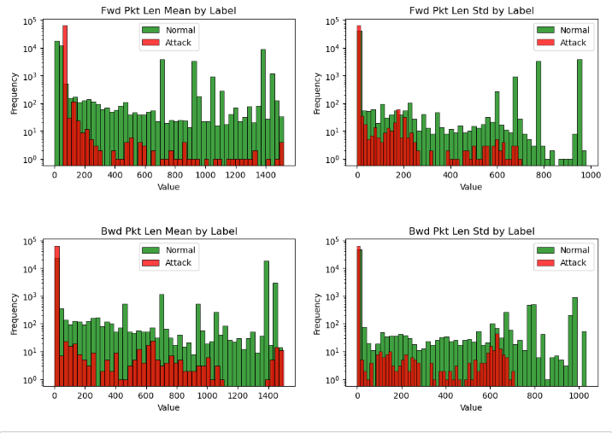
Packet lengths for Attack and Normal Traffic
normal traffic flow is usually consistent with minor spikes. However, attacks are concentrated and not distributed, with certain high spikes

Slide 11
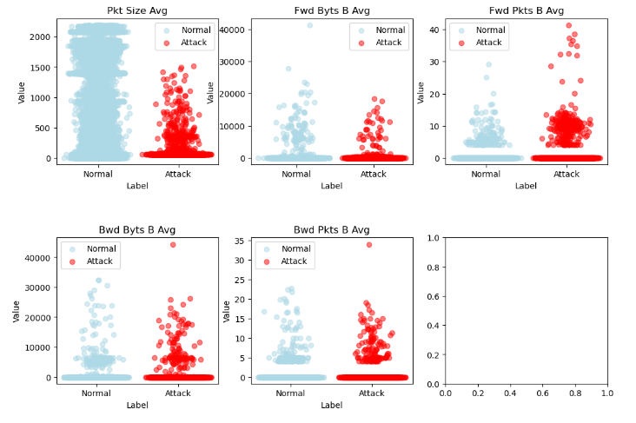
Average Packet size for Attack & Normal Traffic
pkt_size_avg - The average size of packets in the network flow fwd_byts_b_avg - The average number of bytes sent in the forward direction per second fwd_pkts_b_avg - The average number of packets sent in the forward direction per second bwd_byts_b_avg - The average number of bytes sent in the backward direction per second bwd_pkts_b_avg - The average number of packets sent in the backward direction per second
The packet sizes for attack traffic are not very large. However, we see the number of packets sent per second is very high in attack traffic

Slide 12
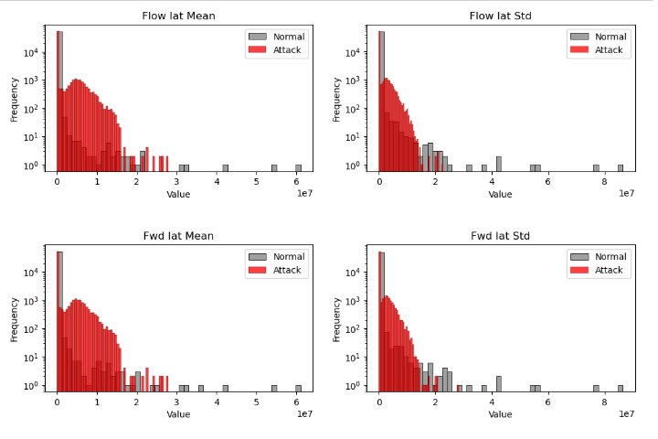
Inter-arrival time for Attack & Normal Traffic
flow_iat_mean - The mean time between two packets sent in the flow, considering all packets in both forward and backward directions flow_iat_std - The standard deviation of the inter-arrival time between packets in the flow, considering all packets in both forward and backward directions fwd_iat_mean - The mean time between two packets sent in the forward direction fwd_iat_std - The standard deviation of the inter-arrival time between packets in the forward direction bwd_iat_mean - The mean time between two packets sent in the backward direction bwd_iat_std - The standard deviation of the inter-arrival time between packets in the backward direction
Attack patterns seem to be flooding the network and creating congestion. Normal traffic is evenly distributed & attack patterns show congestion and possible anomalies

Slide 13
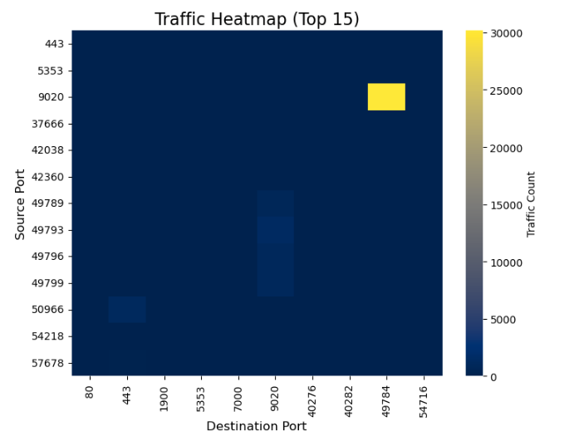
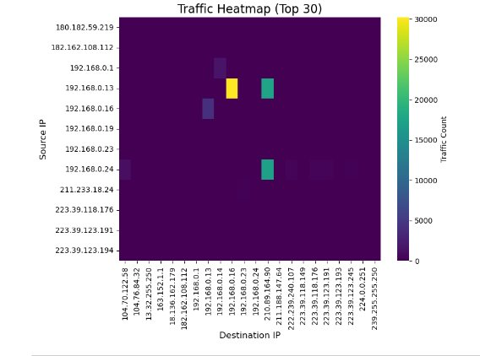
Majority of the traffic is concentrated around few IP addresses and Ports

Slide 14
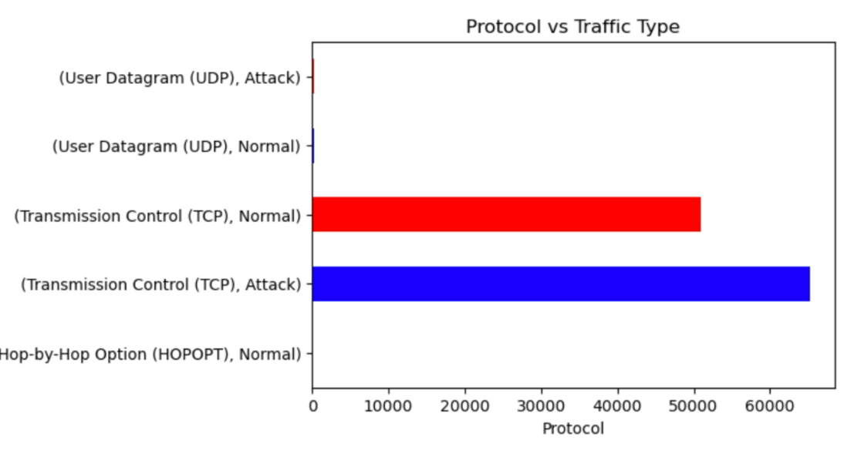
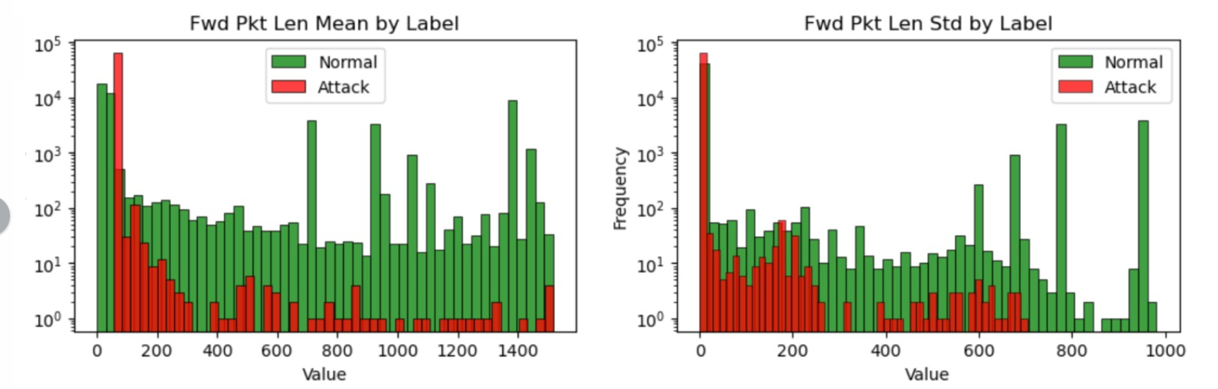
Feature Selection
Dropping timestamp related columns as no trend is observed.
Scaling all the numerical features and analysing the outliers to get patterns.
Dropping columns like source and destination ip and port numbers as they do not have any impact.
Removing UDP protocol data as their count very minimal and then dropping the protocol related feature.
Analysing correlation among features using correlation matrix

Slide 15
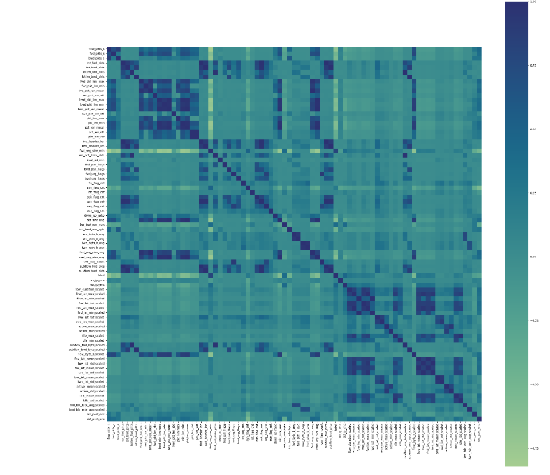
Correlation Matrix
Analysing the matrix to check the relationship among variables
All features with coefficient greater than 0.85 are dropped.

Slide 16
Modeling
The following models are chosen
Logistic Regression
Decision Trees
Random Forest
Naïve Bayes
SVM
MLP
XG Boost

Slide 17
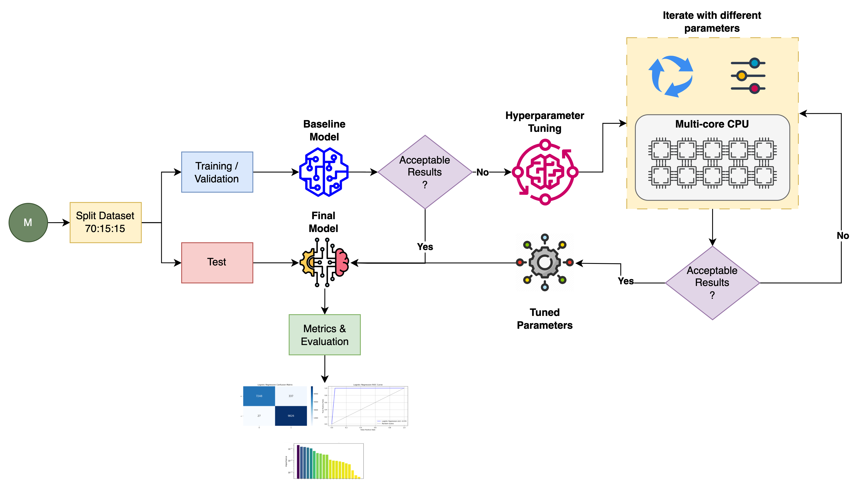
Modelling Flow

Slide 18
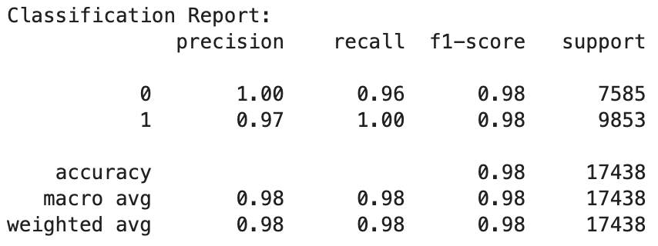
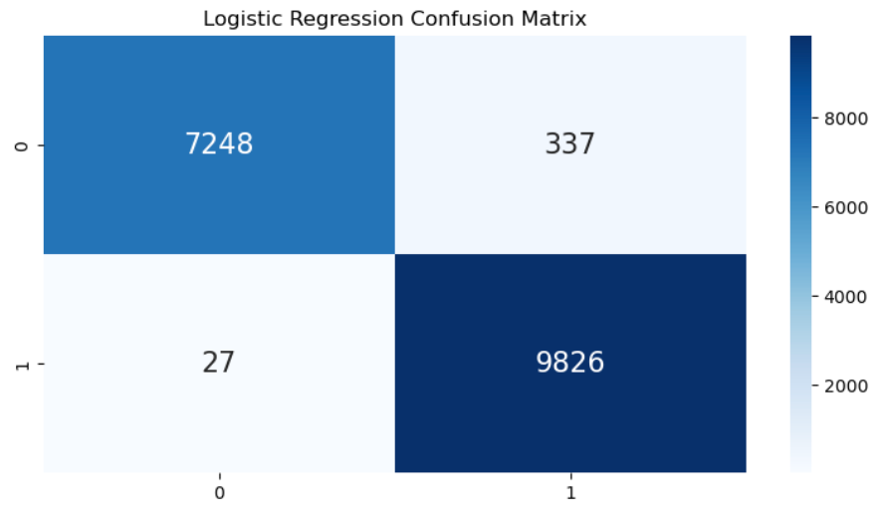
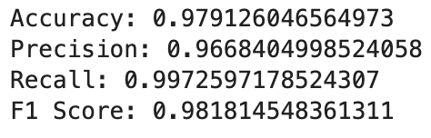
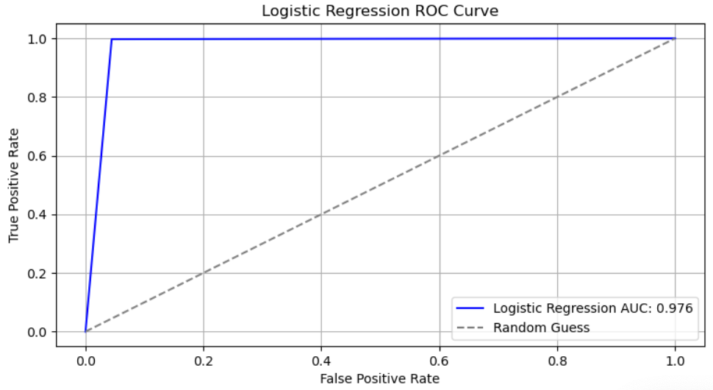
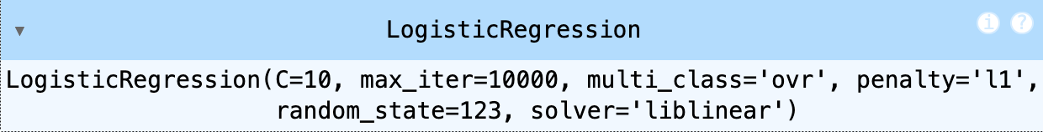
Logistic Regression
Logistic regression is ideal for binary classification tasks
Logistic regression provides interpretable results
Logistic regression is computationally efficient and can handle large datasets
Logistic regression often serves as a baseline model for binary classification
Hyperparameter Tuning using Grid Search – Best Parameters

Slide 19
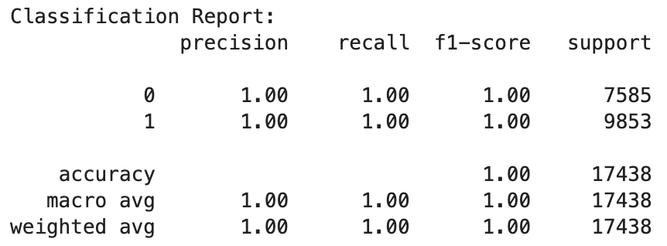
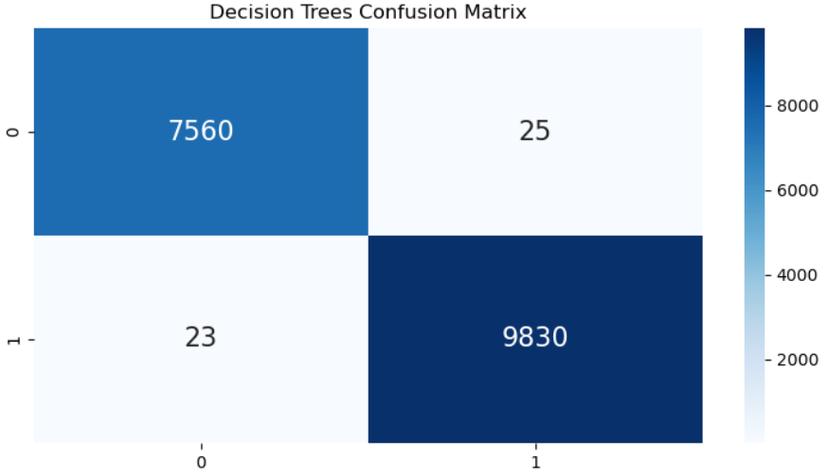
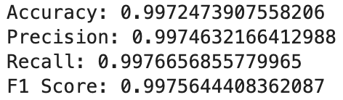
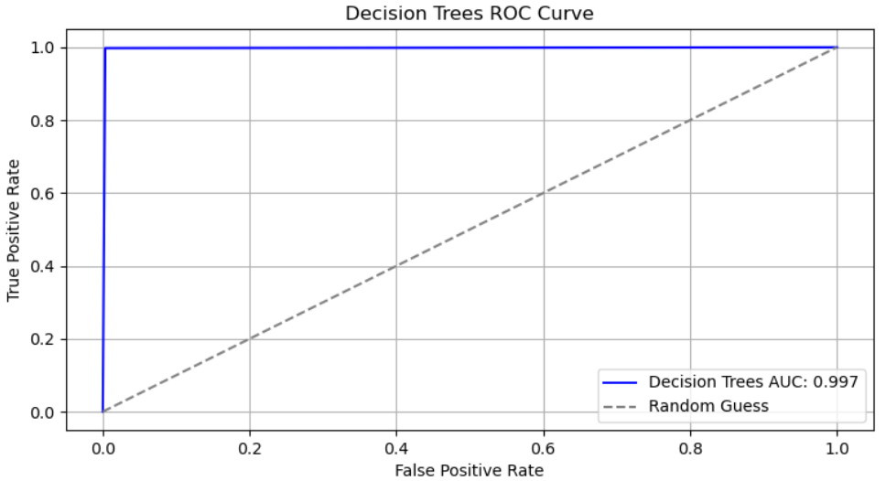
Decision Trees
Decision trees allows users to visualize the decision-making process
Decision trees can capture non-linear relationships in the dataset
Decision trees can handle both numerical and categorical data
Decision trees serve as the building blocks for ensemble learning
Hyperparameter Tuning using Grid Search – Skipped
Baseline Model performed well, so we did not perform Hyperparameter tuning for this classifier

Slide 20
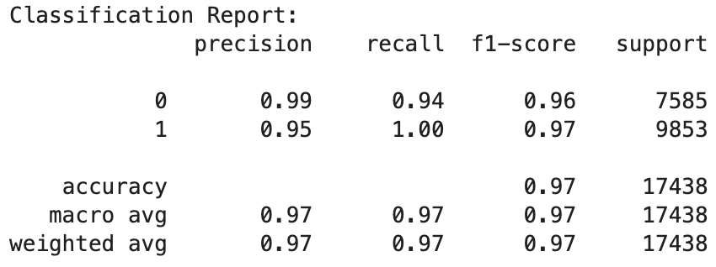
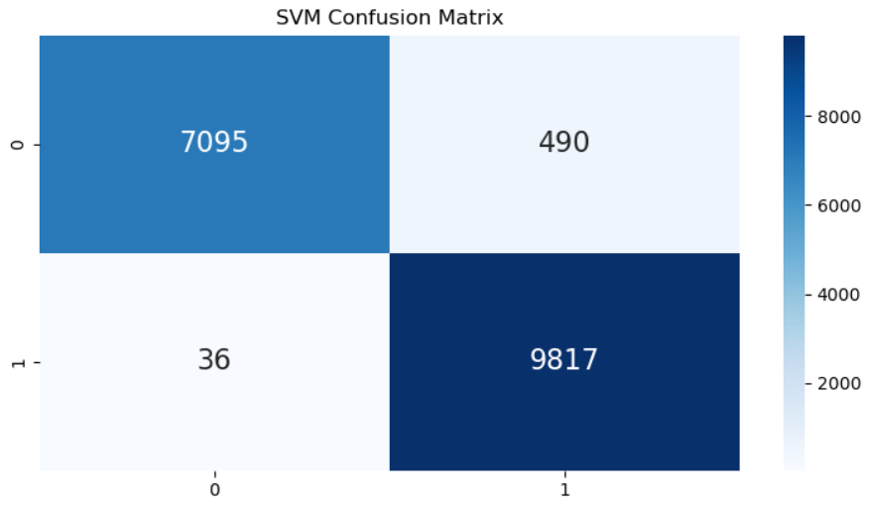
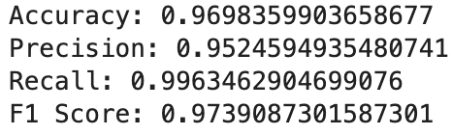
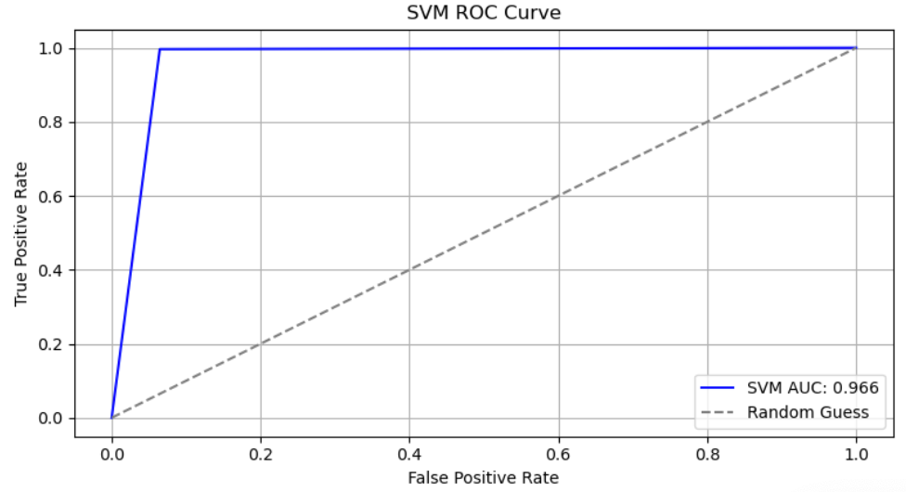
SVM
SVMs are less prone to overfitting
SVM performs well in high-dimensional feature spaces
SVM can effectively model non-linear decision boundaries allowing it to capture complex relationships
SVM offers flexibility through tuning parameters
Hyperparameter Tuning using Grid Search – Best Parameters

Slide 21
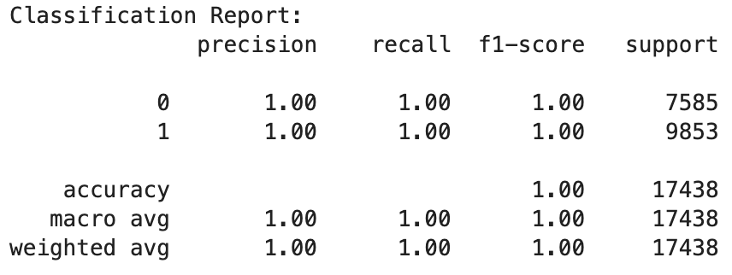
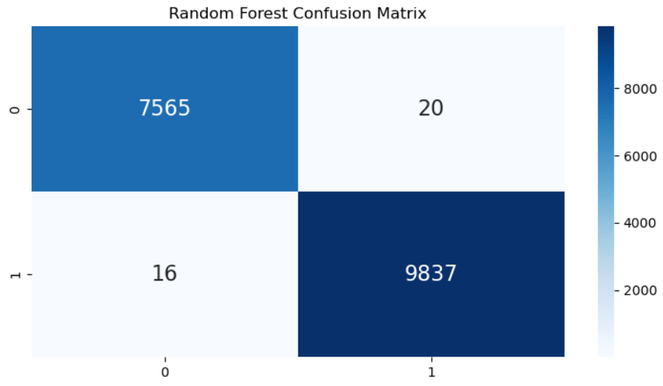
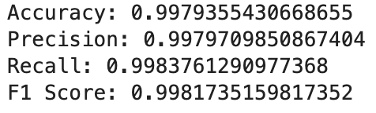
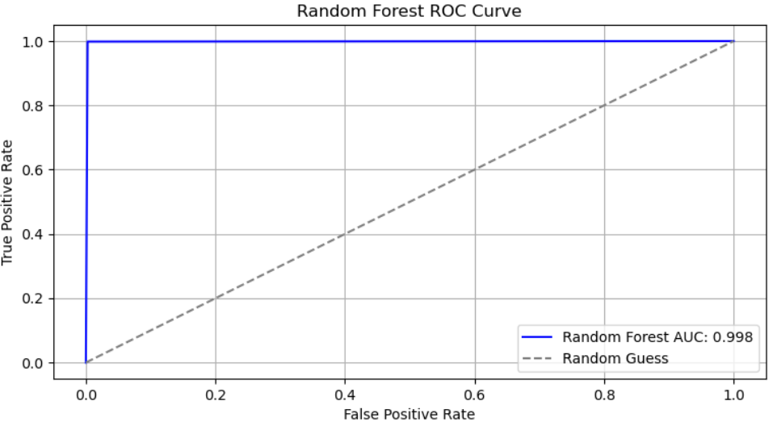
Random Forest
Random Forest naturally mitigates overfitting
Random Forest can effectively capture non-linear relationships and interaction effects between features
Random Forest provides insights into feature importance
Random Forest leverages ensemble learning that results in improved accuracy
Hyperparameter Tuning using Grid Search – Skipped
Baseline Model performed well, so we did not perform Hyperparameter tuning for this classifier

Slide 22
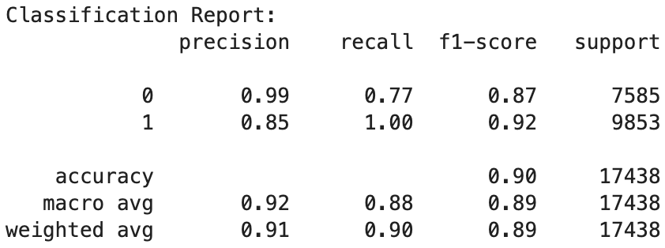
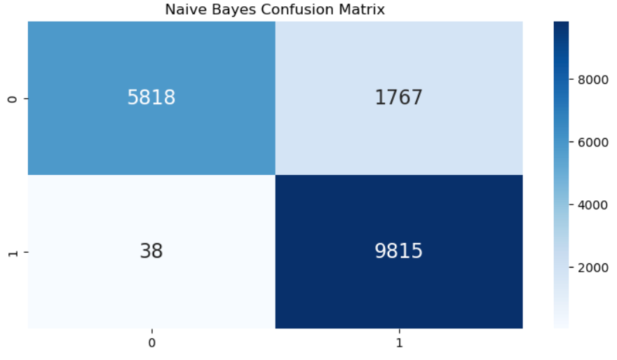
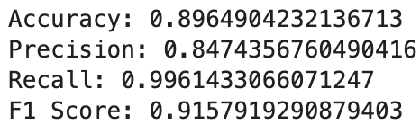
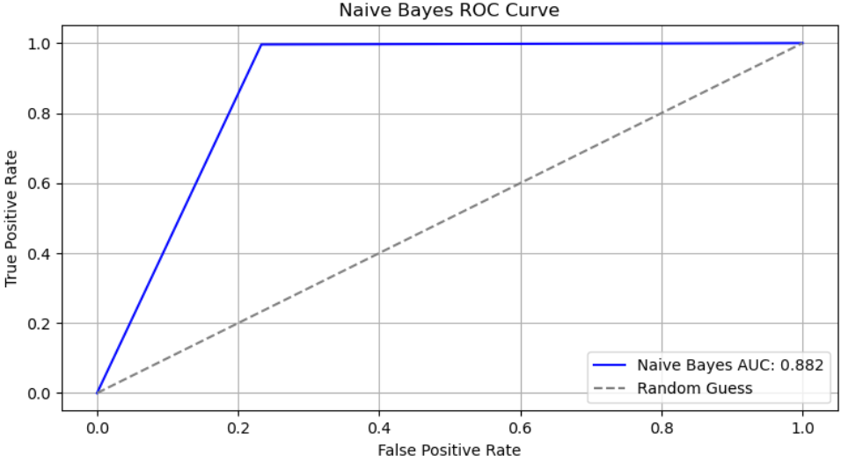
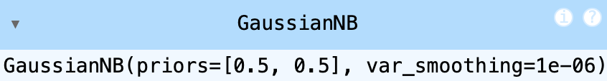
Naïve Bayes
Naive Bayes is computationally efficient and has a simple implementation
Naive Bayes performs well in high-dimensional data
Naive Bayes is robust to irrelevant features
Naive Bayes models can be trained quickly
Hyperparameter Tuning using Grid Search – Best Parameters

Slide 23
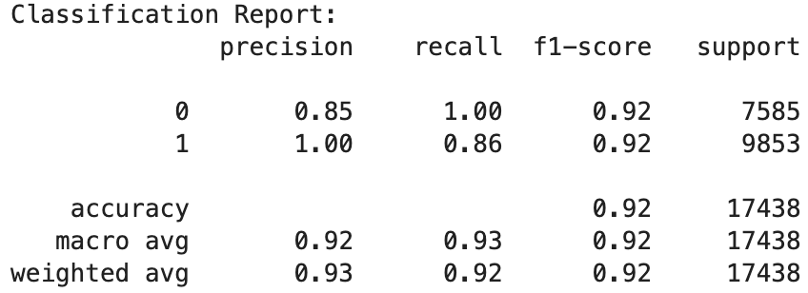
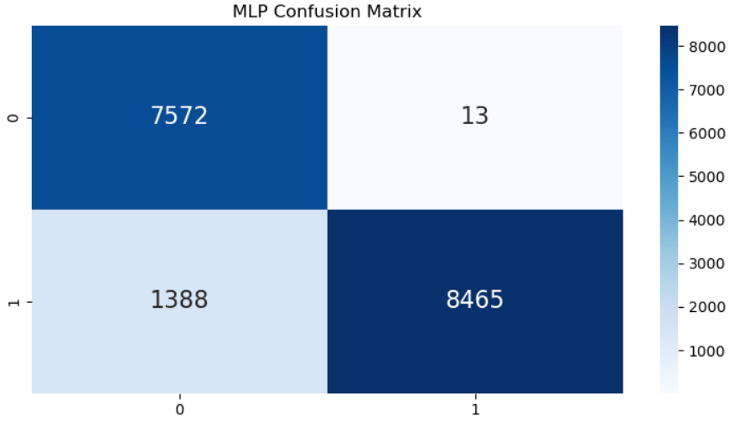
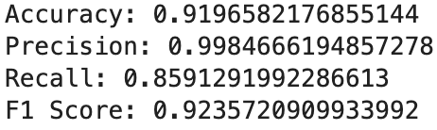
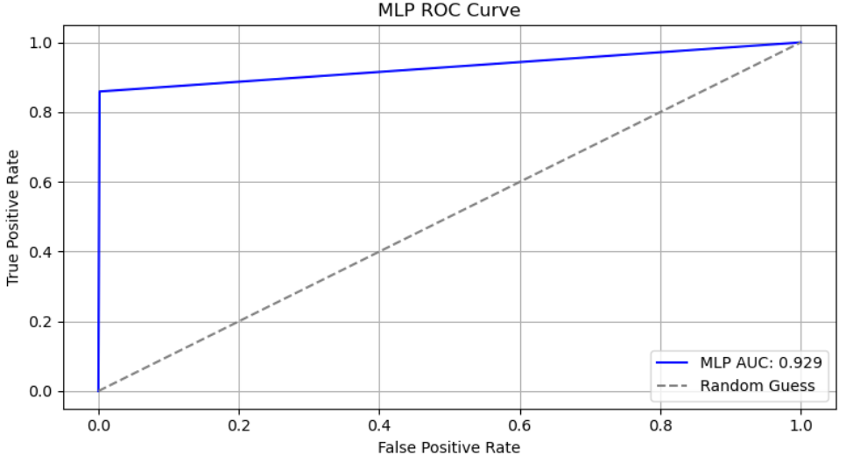
MLP (Multi-Layer Perceptron)
MLP adapts to various Activation Functions and Architectures
MLP can scale to large datasets and accommodate high-dimensional data
MLPs are capable of learning complex patterns
MLPs excel at automatically discerning hierarchical data representations using multiple layers of neurons
Hyperparameter Tuning using Grid Search – Skipped
Baseline Model performed well, so we did not perform Hyperparameter tuning for this classifier

Slide 24
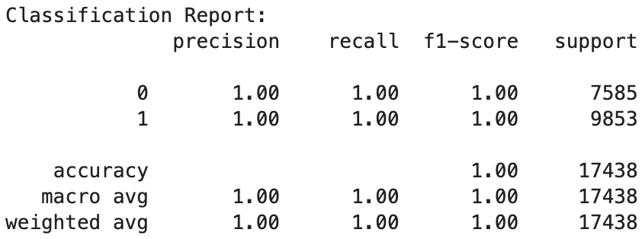
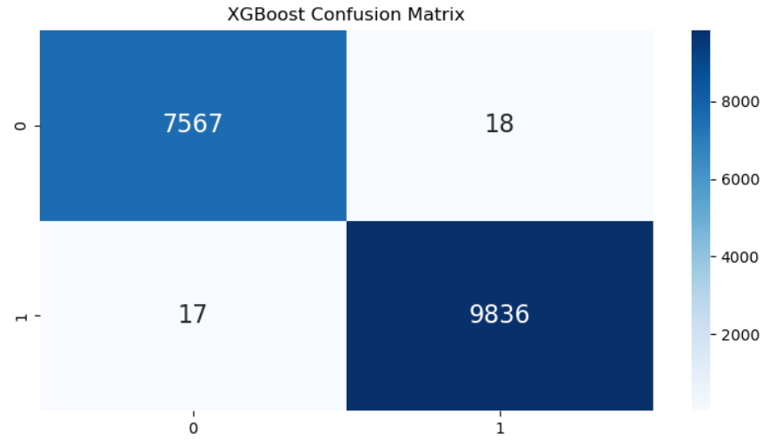
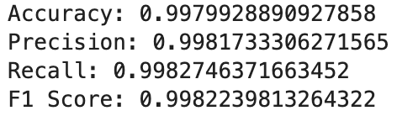
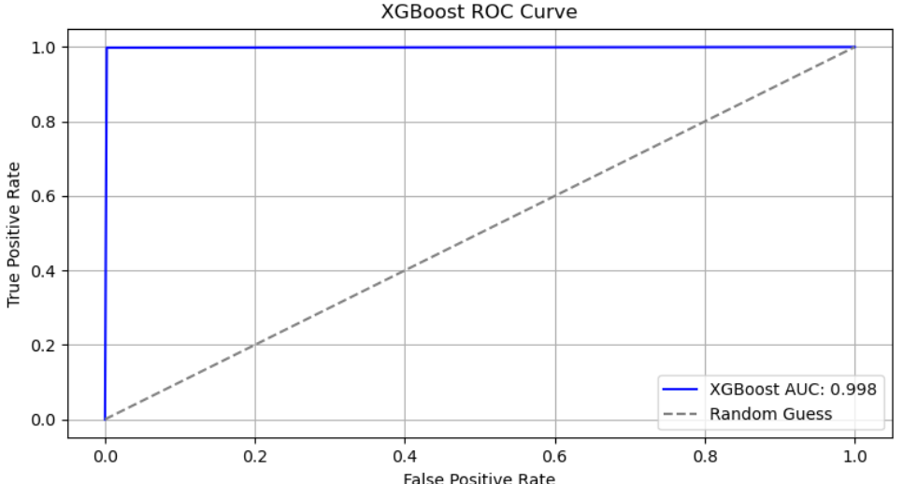
XGBoost
XGBoost is highly efficient and scalable, capable of handling large datasets
XGBoost implements various regularization techniques to prevent overfitting
XGBoost stand out for its performance with ensemble learning
XGBoost can capture complex relationships
Hyperparameter Tuning using Grid Search – Skipped
Baseline Model performed well, so we did not perform Hyperparameter tuning for this classifier

Slide 25
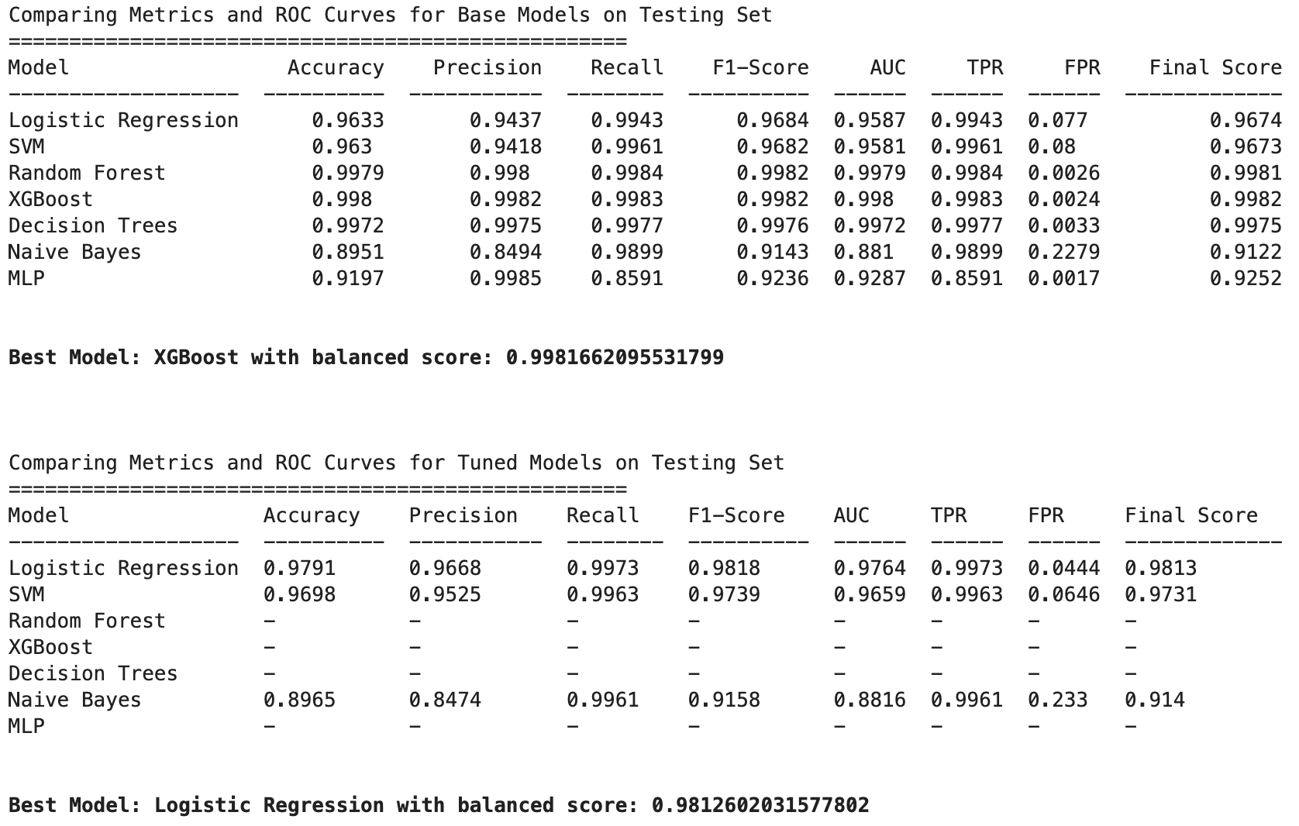
Model Comparison – Evaluation Metrics
Baseline - Best Performing
XGBoost
99.8 % Accuracy
Tuned - Best Performing
Logistic Regression
97.9 % Accuracy
Overall - Best Performing
XGBoost
99.8 % Accuracy

Slide 26
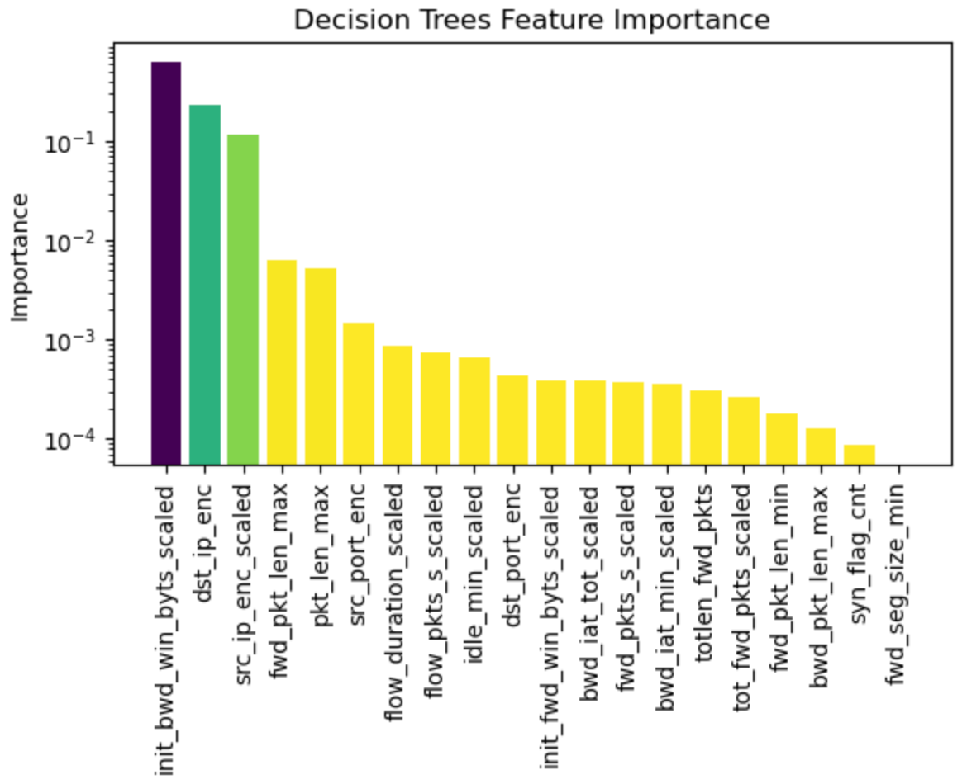
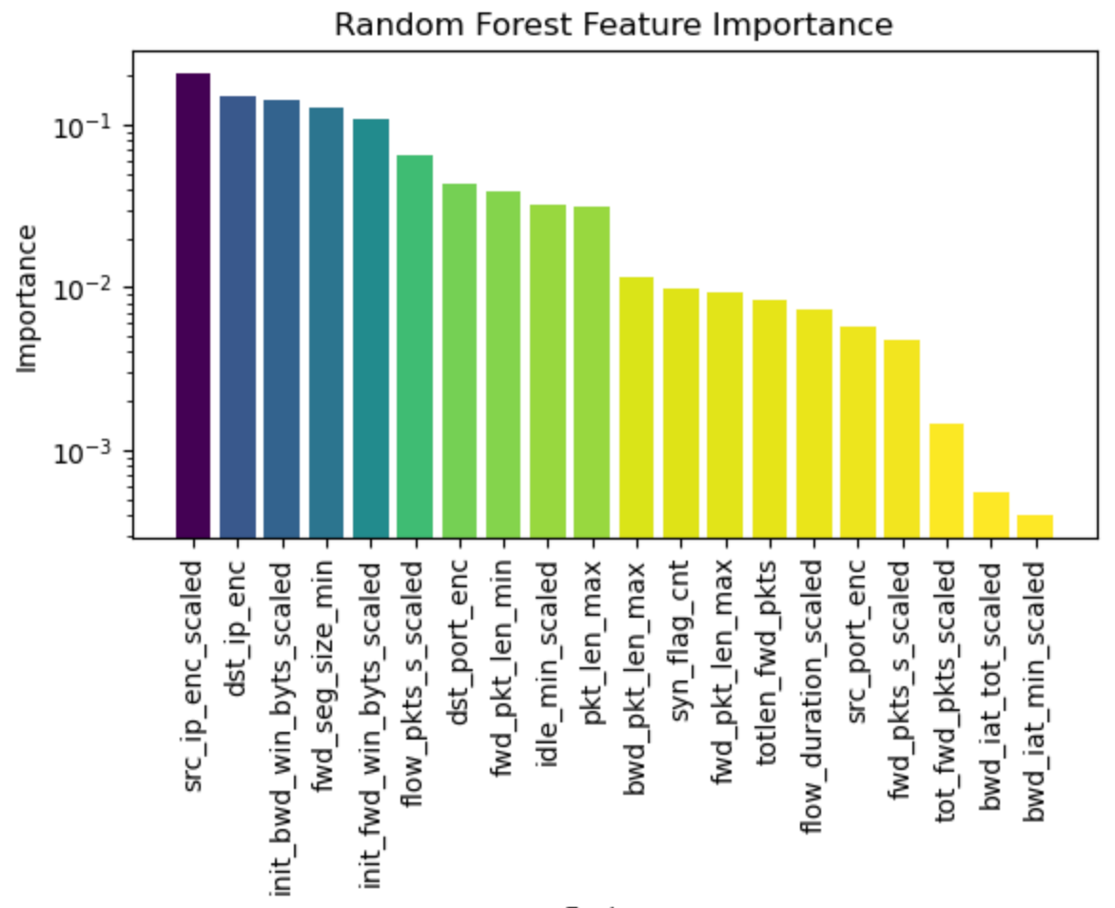
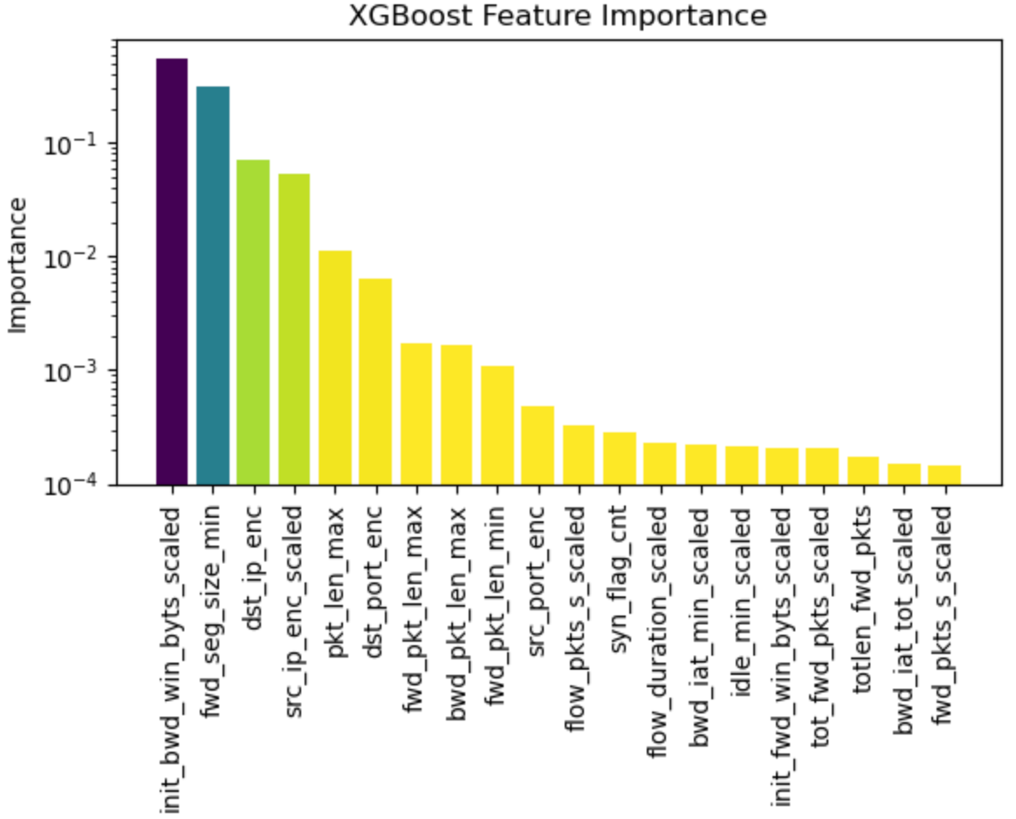
Feature Importance – Top 3 Models (> 99% Accuracy)

Slide 27
Summary
Performed feature engineering on dataset which resulted in selecting the top 20 features, we aimed to enhance model performance and accuracy.
Initial assessment of base models revealed satisfactory performance. Few models were hyperparameter tuned to obtain optimal results.
Ensemble methods i.e XGBoost and Random Forest outperformed other models
Naive Bayes exhibited relatively lower performance compared to other models.

Slide 28
Thank you

